Slide 1
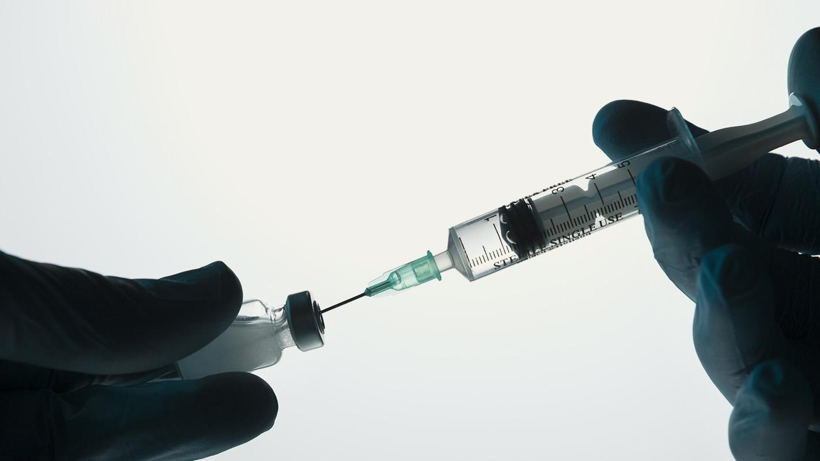
Pigs, Bats & Microchips

Slide 2
Using Survey Data as a Predictor of Pandemic Vaccination
Rajeev Ranjan

Slide 3
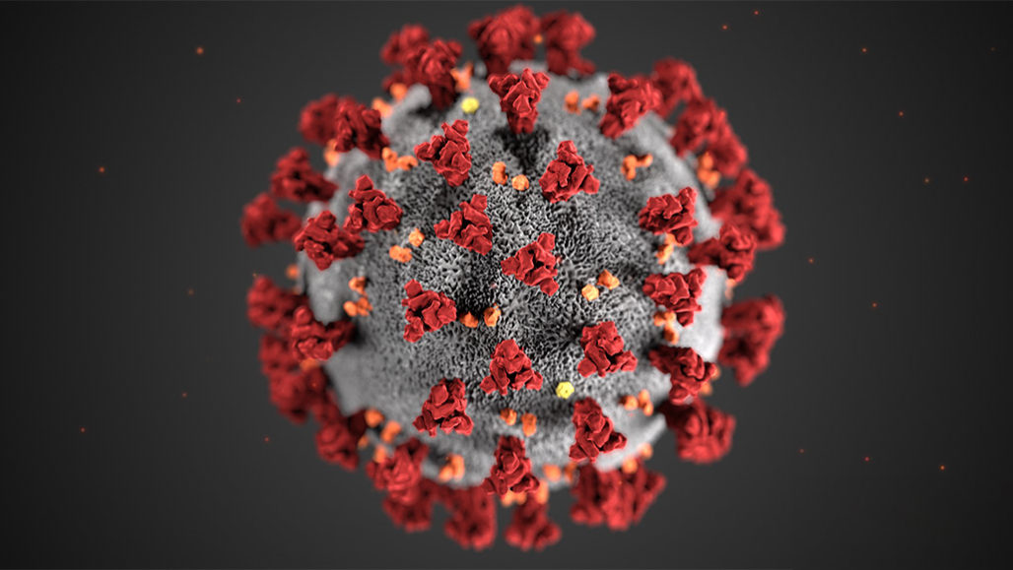
Covid-19
In the USA as of March 4, 2021:
29,130,219
Confirmed cases
525,560
Deaths
> 2.4 million deaths globally

Slide 4
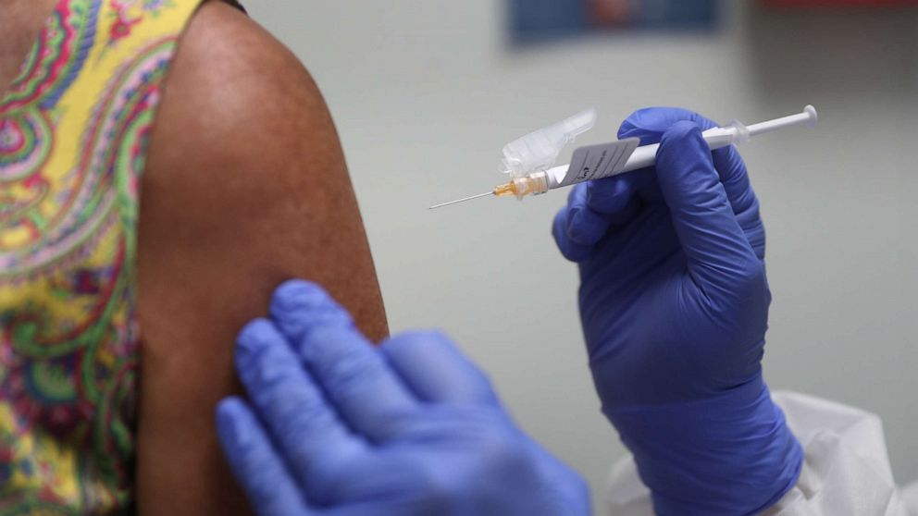
Vaccination is Key
Began: Dec. 20th
Progress:
15.5% one dose
7.8% fully vaccinated
Need: 75% to 85% to be effective

Slide 5
Vaccination is Key
Began: Dec. 20th
Progress:
15.5% one dose
7.8% fully vaccinated
Need: 75% to 85% to be effective
Only 49% of <65yo said they would…*
* According to a Dec. 2020 poll of adults in USA.

Slide 6
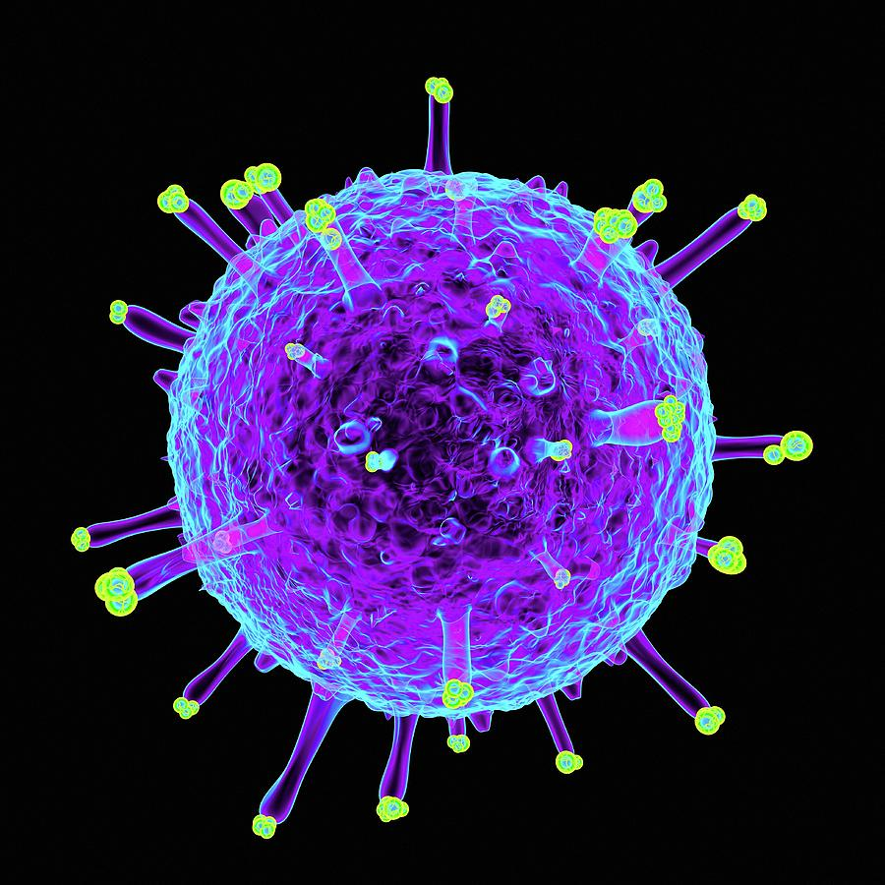
H1N1: (swine flu)
In the USA 2009/2010*:
60,800,000
Confirmed cases
12,469
Deaths
April 2009 – viral pandemic
~ 573,000 deaths globally
* Based on estimates from the CDC

Slide 7
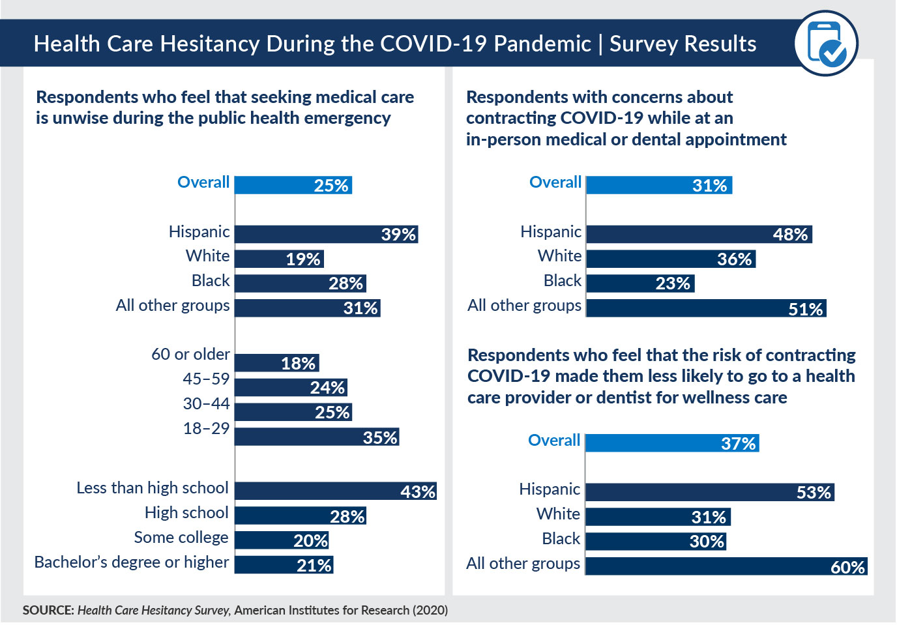
Analyis Questions
Can we use a survey to predict if people got vaccinated (h1n1)?
What are the key factors?
Are there other patterns or groupings to help ID who got vaccinated?
Can we ID current concerns to improve chances of getting vaccinated?

Slide 8
A Muti-Method Approach
2
Clustering
Do any patterns emerge to help tell who got vaccinated?
1
3
Classification
NLP (LDA)
Data from 2009 H1N1 Survey to predict vaccination status
Examine current Tweets to ID why not get vaccinated

Slide 9
1
Classification
Can we predict who got vaccinated and who didn’t? What key features help us predict?

Slide 10
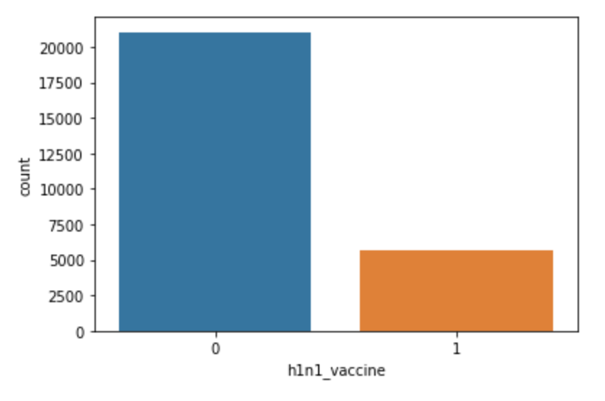
Data & Processing
Phone survey: 2009 to 2010
26,700 responses
36 questions
Class imbalance (79% not vax)
Data Preparation: (Ordinal Encoder and One-Hot; KNN Imputer; StandardScaler; SMOTE)
79%
21%

Slide 11
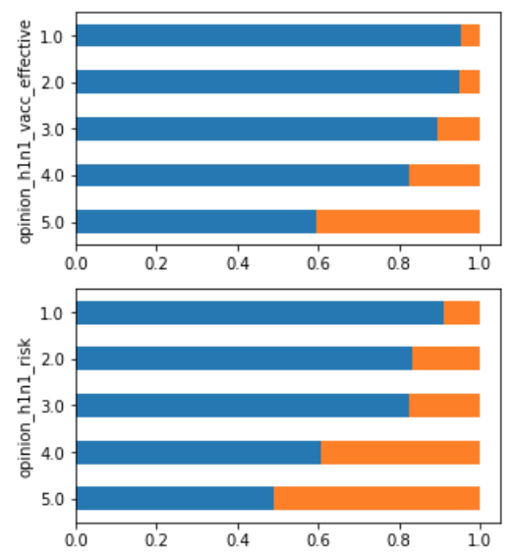
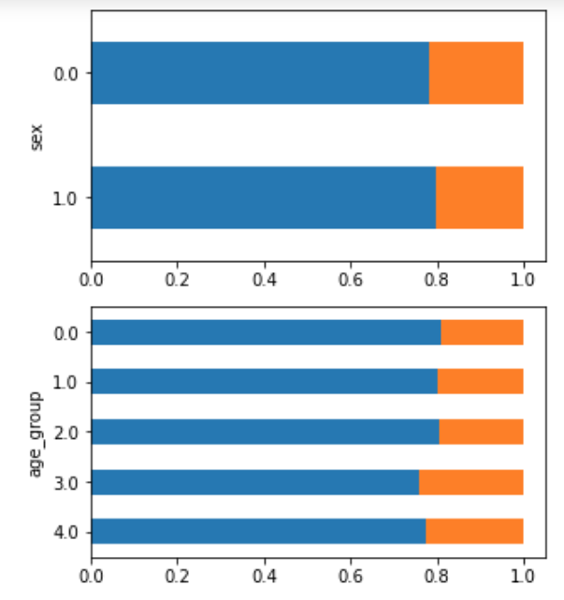
Opinions appear important; demographics less so
Orange bars represent the proportion of respondents that got the H1N1 vaccination

Slide 12
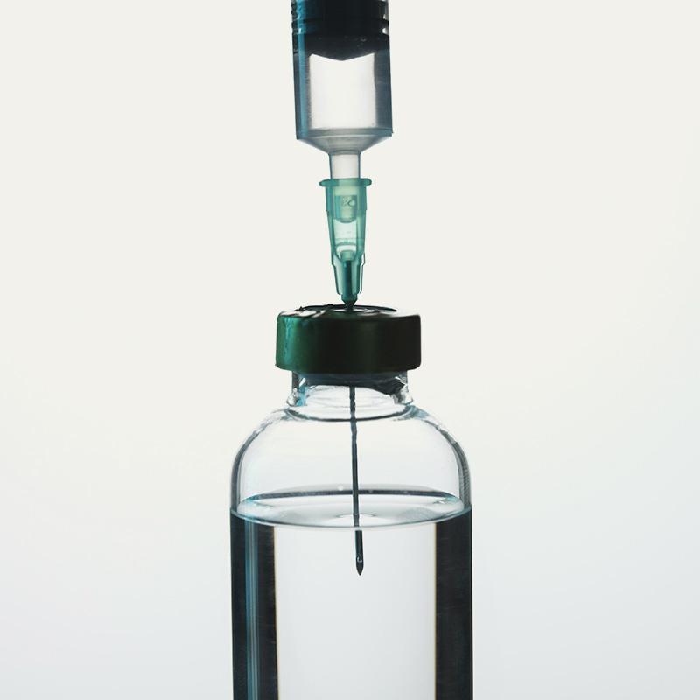
Classification Modeling
6 models:
XGBoost, RandomForest, SVC, LogisticRegeression, KNN, DecisionTrees
Preprocessing & optimization
Model simplification:
19 features 10 features

Slide 13
XGBoost: best results*
.84
.71
Accuracy
Precission (1)
Implication: Ok ability to predict who got vaccinated, but mistakenly claims 29% got vaccined who didn’t.
* This model included: 72 features (lots of one-hot encoding); no SMOTE

Slide 14
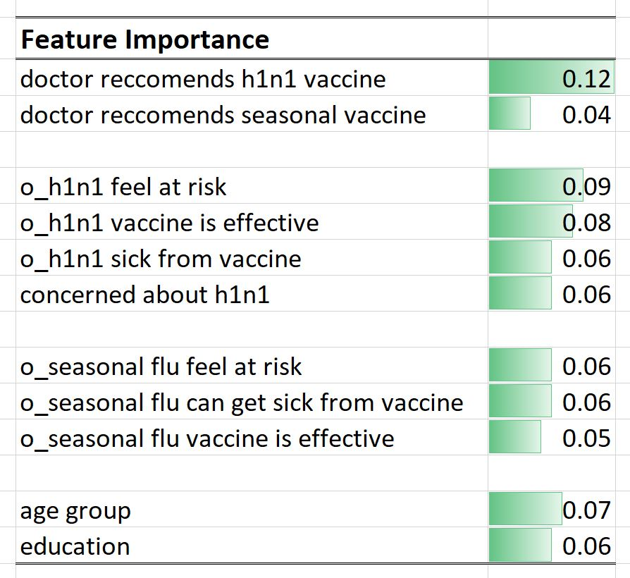
Key Factors
Looked at feature importance from Random Forest models
Consistent across various data preparations and # features.
Doctor recommended is top
Opinions (h1n1; seasonal flu) also important
Demographics less important

Slide 15
2
Clustering
Are there any underlying patterns to tell us WHO got vaccinated or didn’t?

Slide 16
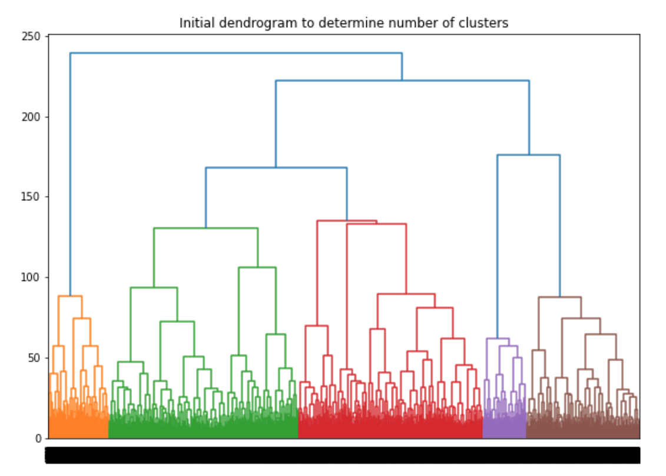
KMeans Clustering
Non-vaccinated set (21,000)
19 variables
Data Imputed and Scaled (KNN Imputer; StandardScaler)
KMeans with 3 groups (3 to 5 suggested)

Slide 17
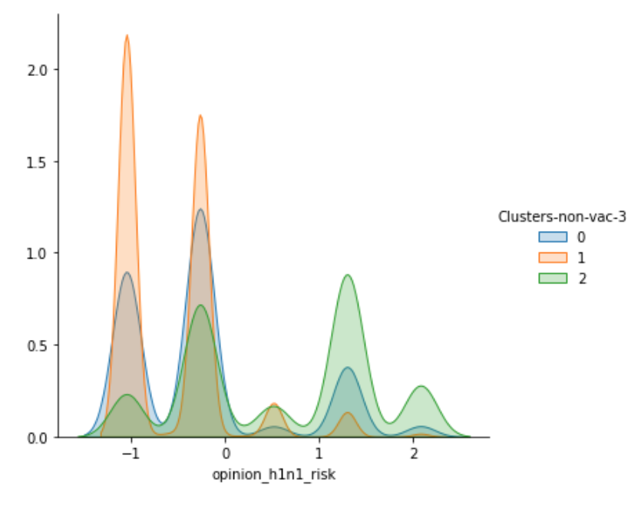
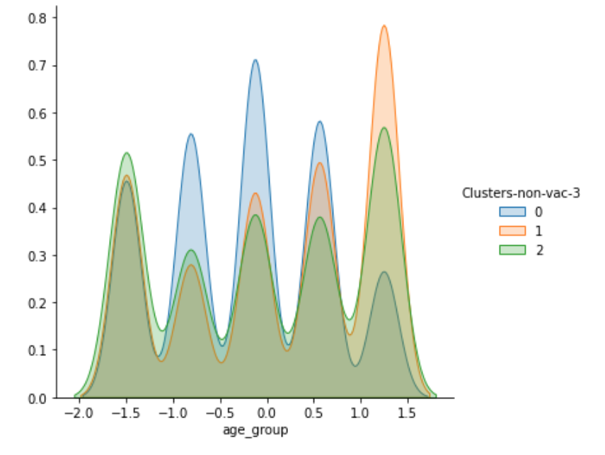
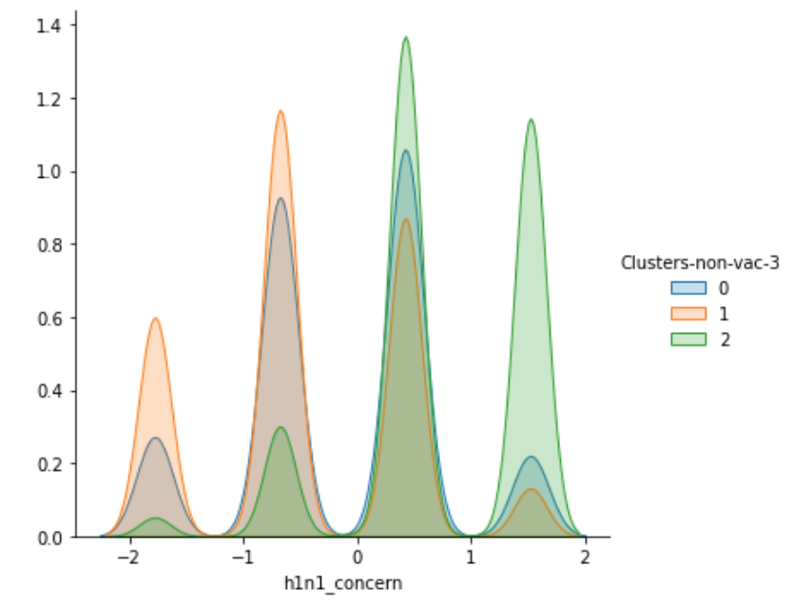
Age, education, opinions, contact
Group 1
Group 0
Group 2
Older, less contact, feel less at risk, lower doct. recc. vax
Younger, more contact, mid-level concern / at risk
Higher knowledge, education, income, higher concern
NOTE: Similar groupings from those who were vaccinated (5,700)

Slide 18
3
NLP
Using sentiment analysis and soft clustering what CONCERNS need to be communicated?

Slide 19
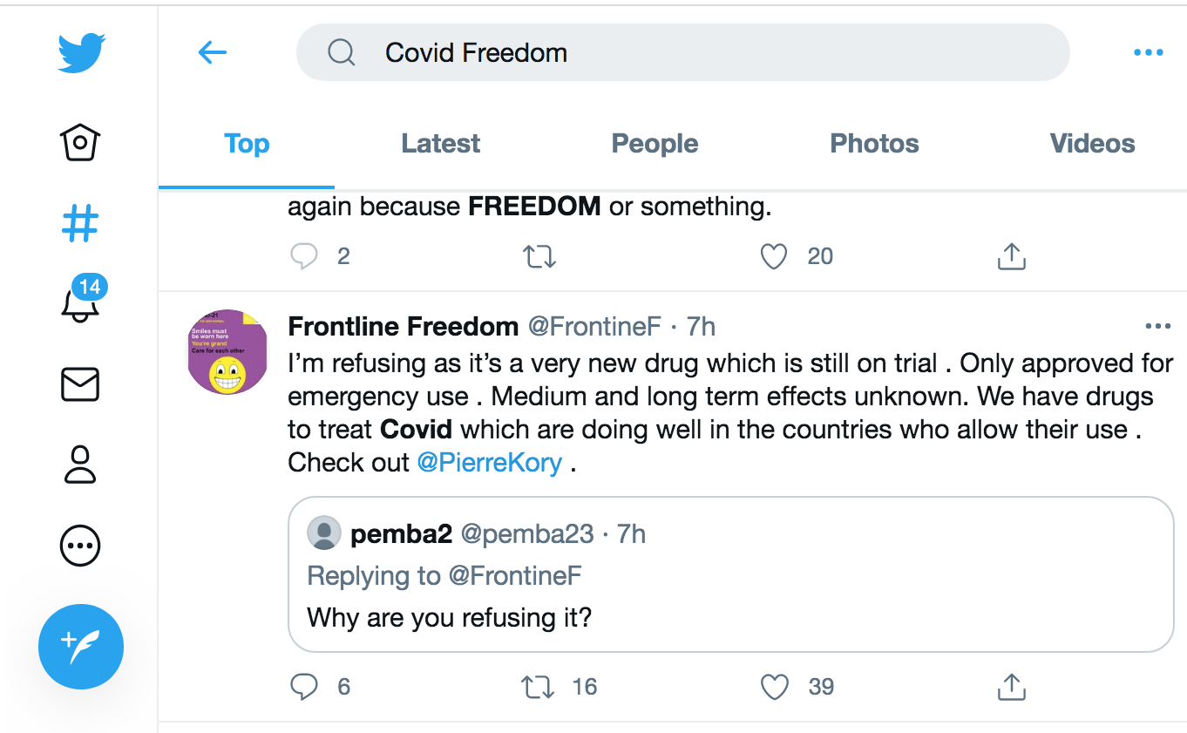
Covid-19 Tweets
via Twint (Feb. 2020 to present; EN; at least 5 likes)
2 sets: neutral; negative
“covid vaccination” (26K)
“covid death”, “vaccine choice”, “vaccine freedom”, etc. (38K)
TextBlob used to id negative sentiment tweets

Slide 20
Uncovering Topics and Meaning
1
2
3
4
List Top Words
View Bi-grams & Tri-grams
Topic clustering
Read a sample of tweets

Slide 21
1
2
List Top Words
View Bi-grams & Tri-grams
freedom
refuse
prevent
petition
restrictions
serious
bad
long
term
don’t
worst
sick
dangerous
stop
lockdown
trump
pfizer
rushed, vaccine
vaccine, trial
cause, death
unnecessary, death
bill, gates
freedom, choice
medical, freedom
vaccine, passport
don’t, want
serious, side, effect
long, term, side
petition, prevent, restrictions
unknown, long, term
within, 28, days
Note: positive set similar but also – getting, received, want; good, better, great; safe, zero side effects, 100% effective, works

Slide 22
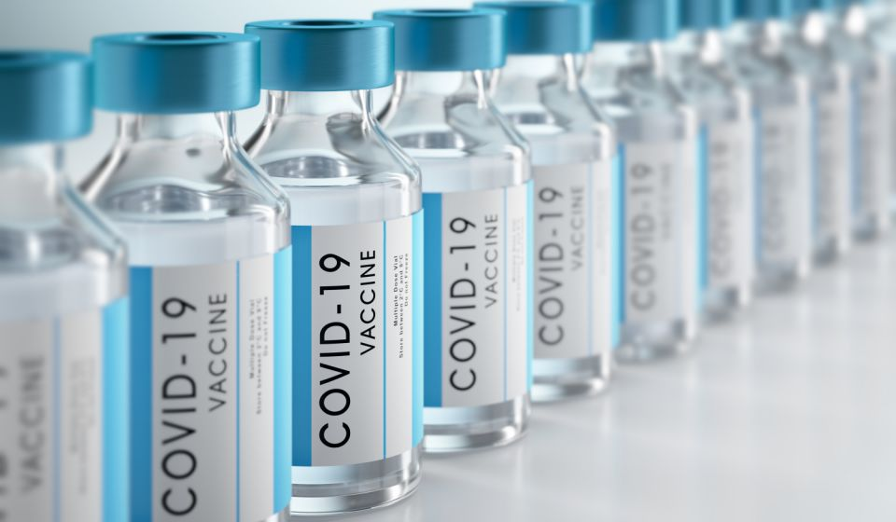
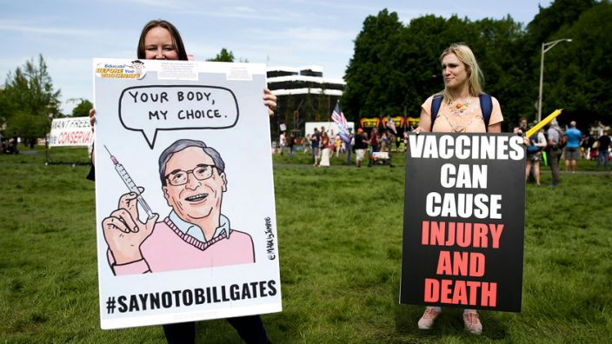
Topic clustering & reading
3, 4
Vaccine:
Process:
ineffective, rushed, not tested, side effects, deaths
forced, status tracked, denial of services, lack of choice / freedom
Actions:
Political / News:
sign petition to prevent restrictions; protest – close vacc. site
Bill Gates, WHO, Democrats, government, big pharma, church; microchip, medical exp.

Slide 23
Example Tweets
“…Rushed, experimental, untested vaccine with a tracking chip…”
“I am a healthy 53 yr old and I am not going near that vaccine. You watch, there will be some profound side effects to this thing they rushed through.”
“This is AMERICA. We have FREEDOM. Where your fear begins, my rights don’t end.”
“If you have a death wish, take the vaccine.”
“…Either fight for your freedom or remain passive to the Gov’ts will. I will not take a vaccine that Bill Gates has a hand in and I’m damn sure not going to submit to being microchipped.”

Slide 24
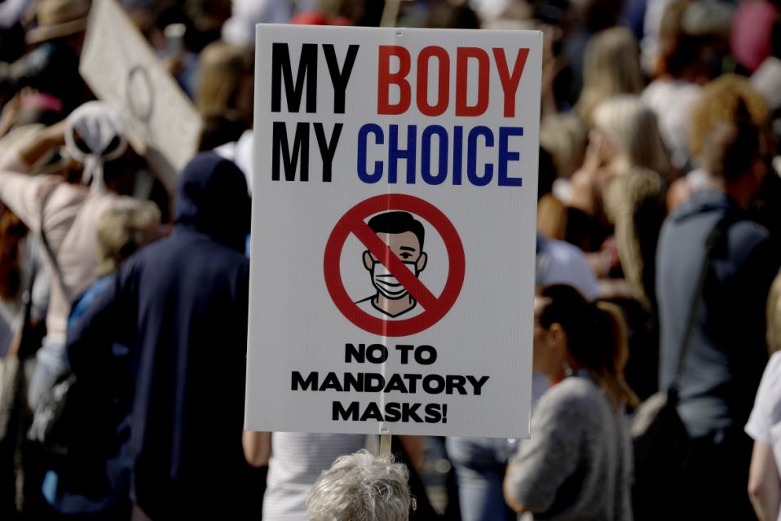
Take-aways
1
2
Survey:
Opinions are key:
Can use to predict if get vaccinated
A driver in determining if get vaccinated
3
4
Tweets:
Feedback Loop:
Help us identify concerns and misinformation
To refine and create future surveys

Slide 25
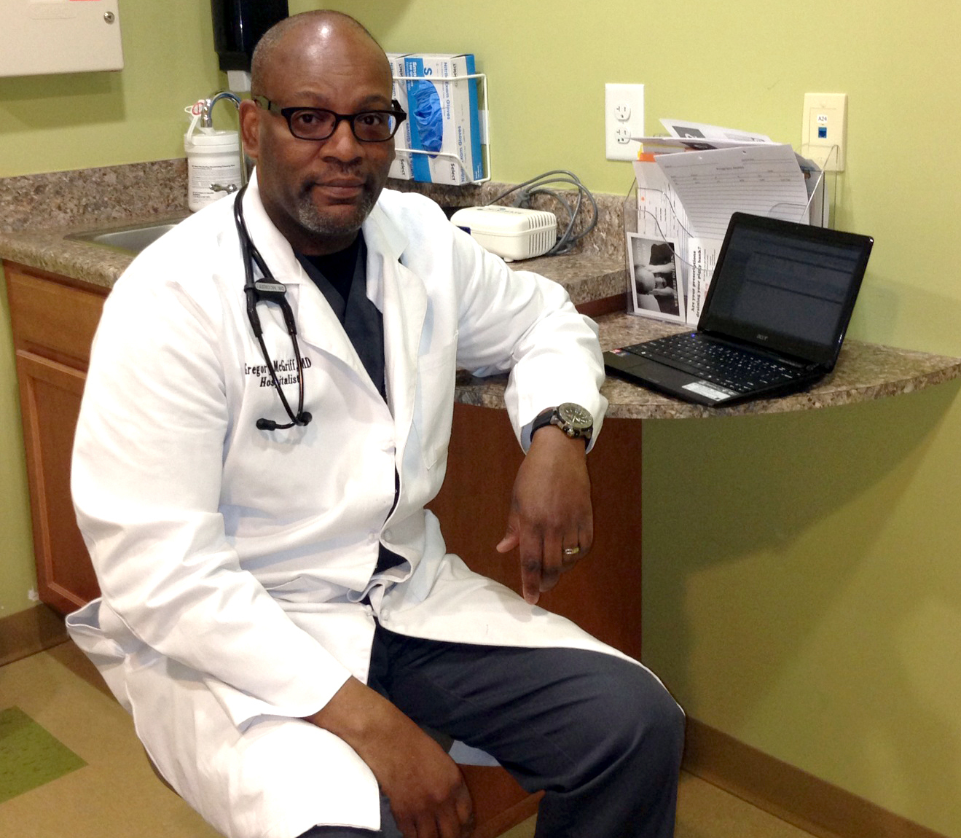
Recommendations
Gain support of local doctors; community leaders
Communicate the facts; address misperceptions
Be equitable and target most needed people / places
Keep alert to trending topics of concern (ongoing data collection)
Bridge federal and state schisms

Slide 26
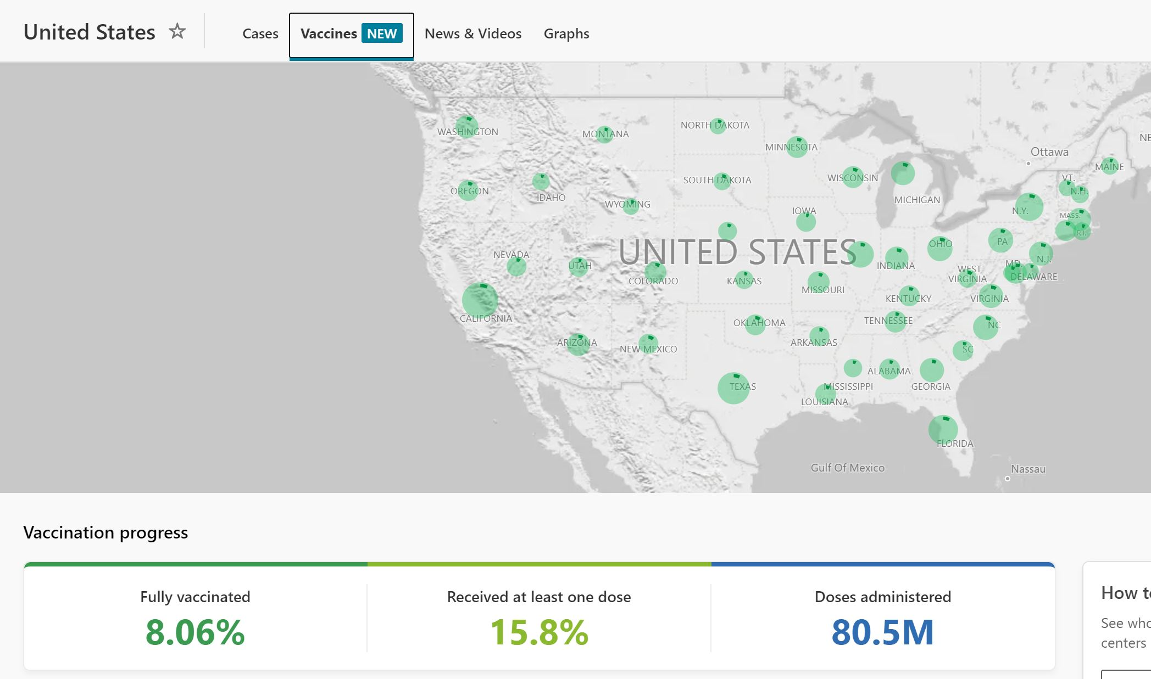
Next Steps
More social media sources; better targeted
Recent survey data; examine change in opinions over time
Geographic dimension to identify places of need
Infographic and Dashboard improvements

Slide 27
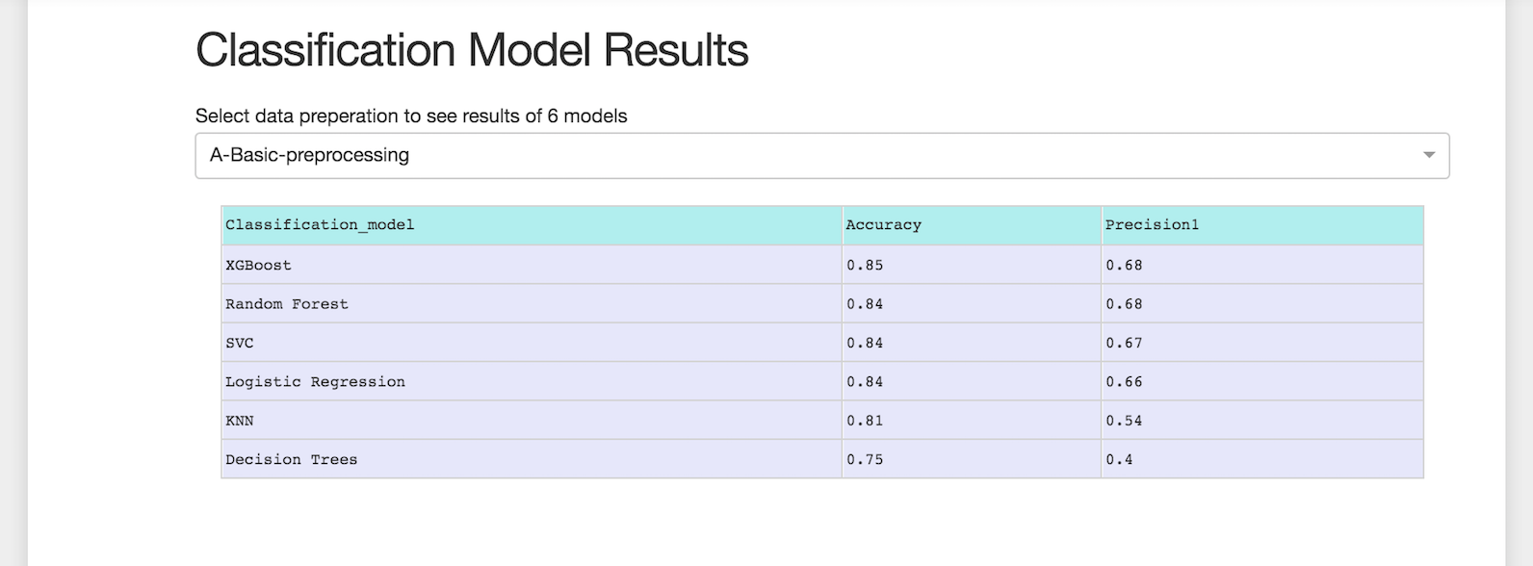
Dashboard… in progress

Slide 28
Thanks

